Slide 1
UML-N36 & UML-N12 Product Introduction
Notes:
Doc Revision: 003
Doc Updated Date: January 15th, 2016
Revised content:
Updated picture and delete “Isolated Island to SAN and NAS” in Page2.
Updated picture, title and description in Page3.
Revised “Support simultaneous NAS & SAN access to the same file” to “Support NAS access to the file” in Page9.
Updated picture in Page11, Page12, Page13, Page15 and Page16.
Doc Revision: 002
Doc Updated Date: September 17th, 2014

Slide 2
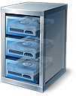
Current Storage Architecture
Low-efficiency Usage for Storage
Complicated Working Process
Easy-access to NAS
NAS

Slide 3
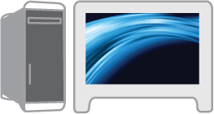
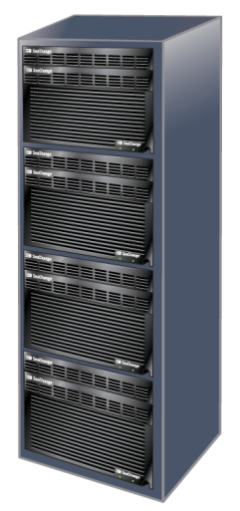
NAS Access
Storage designed for media applications and based on IT
Support NAS access
Media-centric file system
NAS access
Private Cloud Storage
Universal MediaLibrary

Slide 4
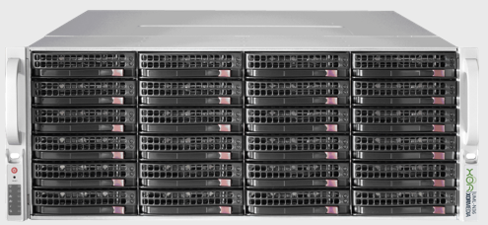
UML N Series Models
UML N36
4RU chassis, accommodating up to 36 hot-plug disks (24 front + 12 rear) Single embedded storage controller Disk options: 1TB/2TB/4TB/8TB disks Random number of disks by your demands (no more than 36pcs) Support cold spare disks RAID0, RAID1, RAID5, RAID6 NAS (2 x 1GbE + 2 x 10GbE, 4 x 1GbE)

Slide 5
UML N Series Models
UML N12
2RU chassis, 12 hot-plug disks Single embedded storage controller Disk options: 1TB/2TB/4TB/8TB disks Random number of disks by your demands (no more than 12pcs)
Support cold spare disks RAID0, RAID1, RAID5, RAID6 NAS (2 x 1GbE +2 x 10GbE, 4 x 1GbE)

Slide 6
High Density (N36)
 | UML-N36 Series
Chassis | 4RU
Maximum Disk Amount | 36 (Full load)
Disk Capacity | 1TB | 2TB | 4TB | 8TB
Maximum Capacity | 36TB | 72TB | 144TB | 288TB
Usable Capacity Relies on RAID Type Example: RAID 5, 8+1, 4 LUNs | 32TB | 64TB | 127TB | 254TB

Slide 7
High Density (N12)
 | UML-N12 Series
Chassis | 2RU
Maximum Disk Amount | 12 (Full load)
Disk Capacity | 1TB | 2TB | 4TB | 8TB
Maximum Capacity | 12TB | 24TB | 48TB | 96TB
Usable Capacity Relies on RAID Type Example: RAID 5, 5+1, 2 LUNs | 10TB | 20TB | 40TB | 80TB

Slide 8
High-Availability (HA)
RAID 0/1/5/6 Protection
No redundancy (RAID0)
Half of redundant disks (RAID1）
1 redundant disk (RAID5)
2 redundant disks (RAID6)
Redundancy and Hot-plug
Power supplies
Fans
HDDs
RAID 0/1/5/6 Protection
Redundancy & Hot-plug
High-density & innovation design

Slide 9
Self-adaptation & Big Data Centralization
Access
Support NAS access to the file
Don’t need reconfiguration or gateways
Media-centric file layout
Space efficiency for small files
High streaming performance for large media files
File Layout
Performance
Fast response time to the index file
Expansibility
Seamless deployment for XOR Media Cloud Storage System (CloudAqua)

Slide 10
UML N36 Series Structure
Server Appearance

Slide 11
UML N36 Series Structure
Back-end
Motherboard Tray (Storage Controller)
6 to 7 Fan Modules
Dual Redundant Power Supplies
24 3.5” Front HDD disks
Front Backplane
Front-end
Notes:
11

Slide 12
UML N36 Series Structure (Continued)
Rear backplane
12 3.5” Rear HDDs
Back-end

Slide 13
End-to-end Storage Management (N36)
SAS Connection
10 GigE Network Connection
GigE Network Connection
Data Flow
Storage Arrays
UML N36
Aqua
CEPH
Ext4
CIFS
FTP
NFS
CIFS client FTP client NFS client

Slide 14
UML N12 Series Structure
Server Appearance

Slide 15
UML N12 Series Structure (Continued)
Front-end
12 x 3.5” HDDs
Dual Redundant Power Supplies
3 Fan Modules
Storage Controller (Motherboard)
Back-end

Slide 16
End-to-end Storage Management (N12 )
SAS Connection
10 GigE Network Connection
GigE Network Connection
Data Flow
Storage Arrays
UML N12
Aqua
CEPH
Ext4
CIFS
FTP
NFS
CIFS client FTP client NFS client

Slide 17
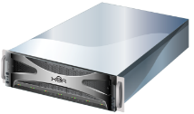
Seamless Integration with CloudAqua
Usage Case
Library
Library
Usage Case
Live
Cloud Aqua object storage
Multi-screen
Archive
Broadcast-level production
Broadcast PTA
Universal MediaLibrary N series
Universal MediaLibrary N series
Video surveillance
Region A
File system plug-in / reset
Region B
3rd-party Application
(access to contents and metadata)

Slide 18
www.xor-media.com
Thank you!

